Slide 1

Formula 1/10th Scale Vehicle
January 30, 2024
By: Aaron Hastie, Adam Imamura, Kyle Lozano, Alex Soriano, Ja’Quan Young
Notes:
Hello everyone we are Team 503 presenting our Design Report 4

Slide 2
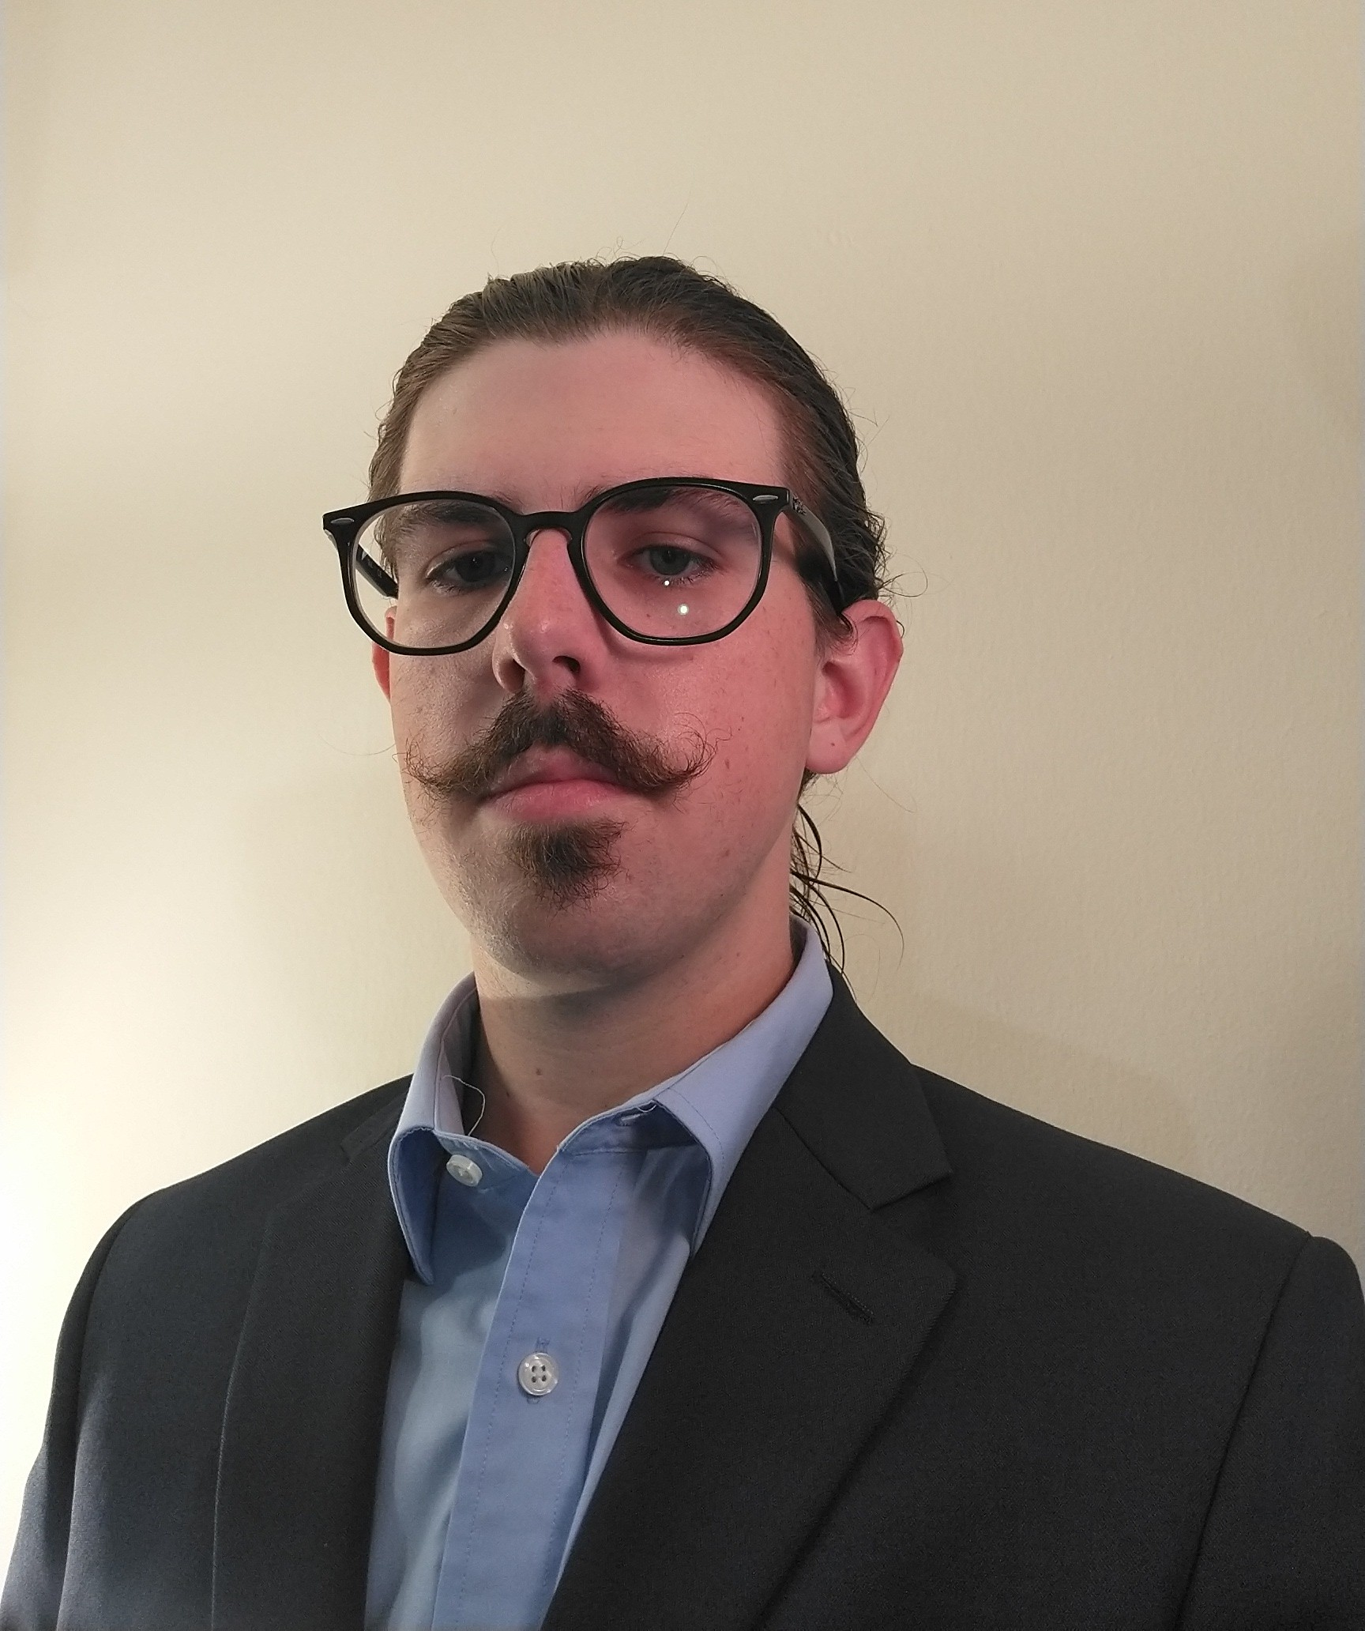

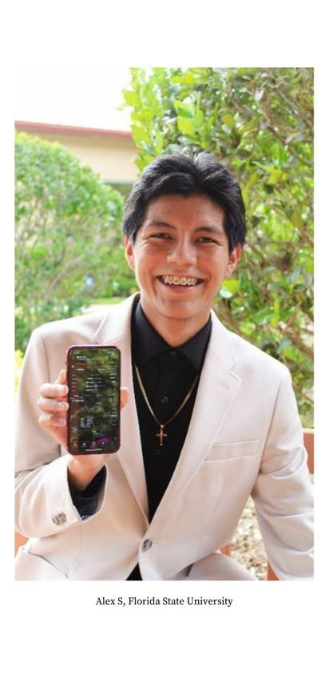
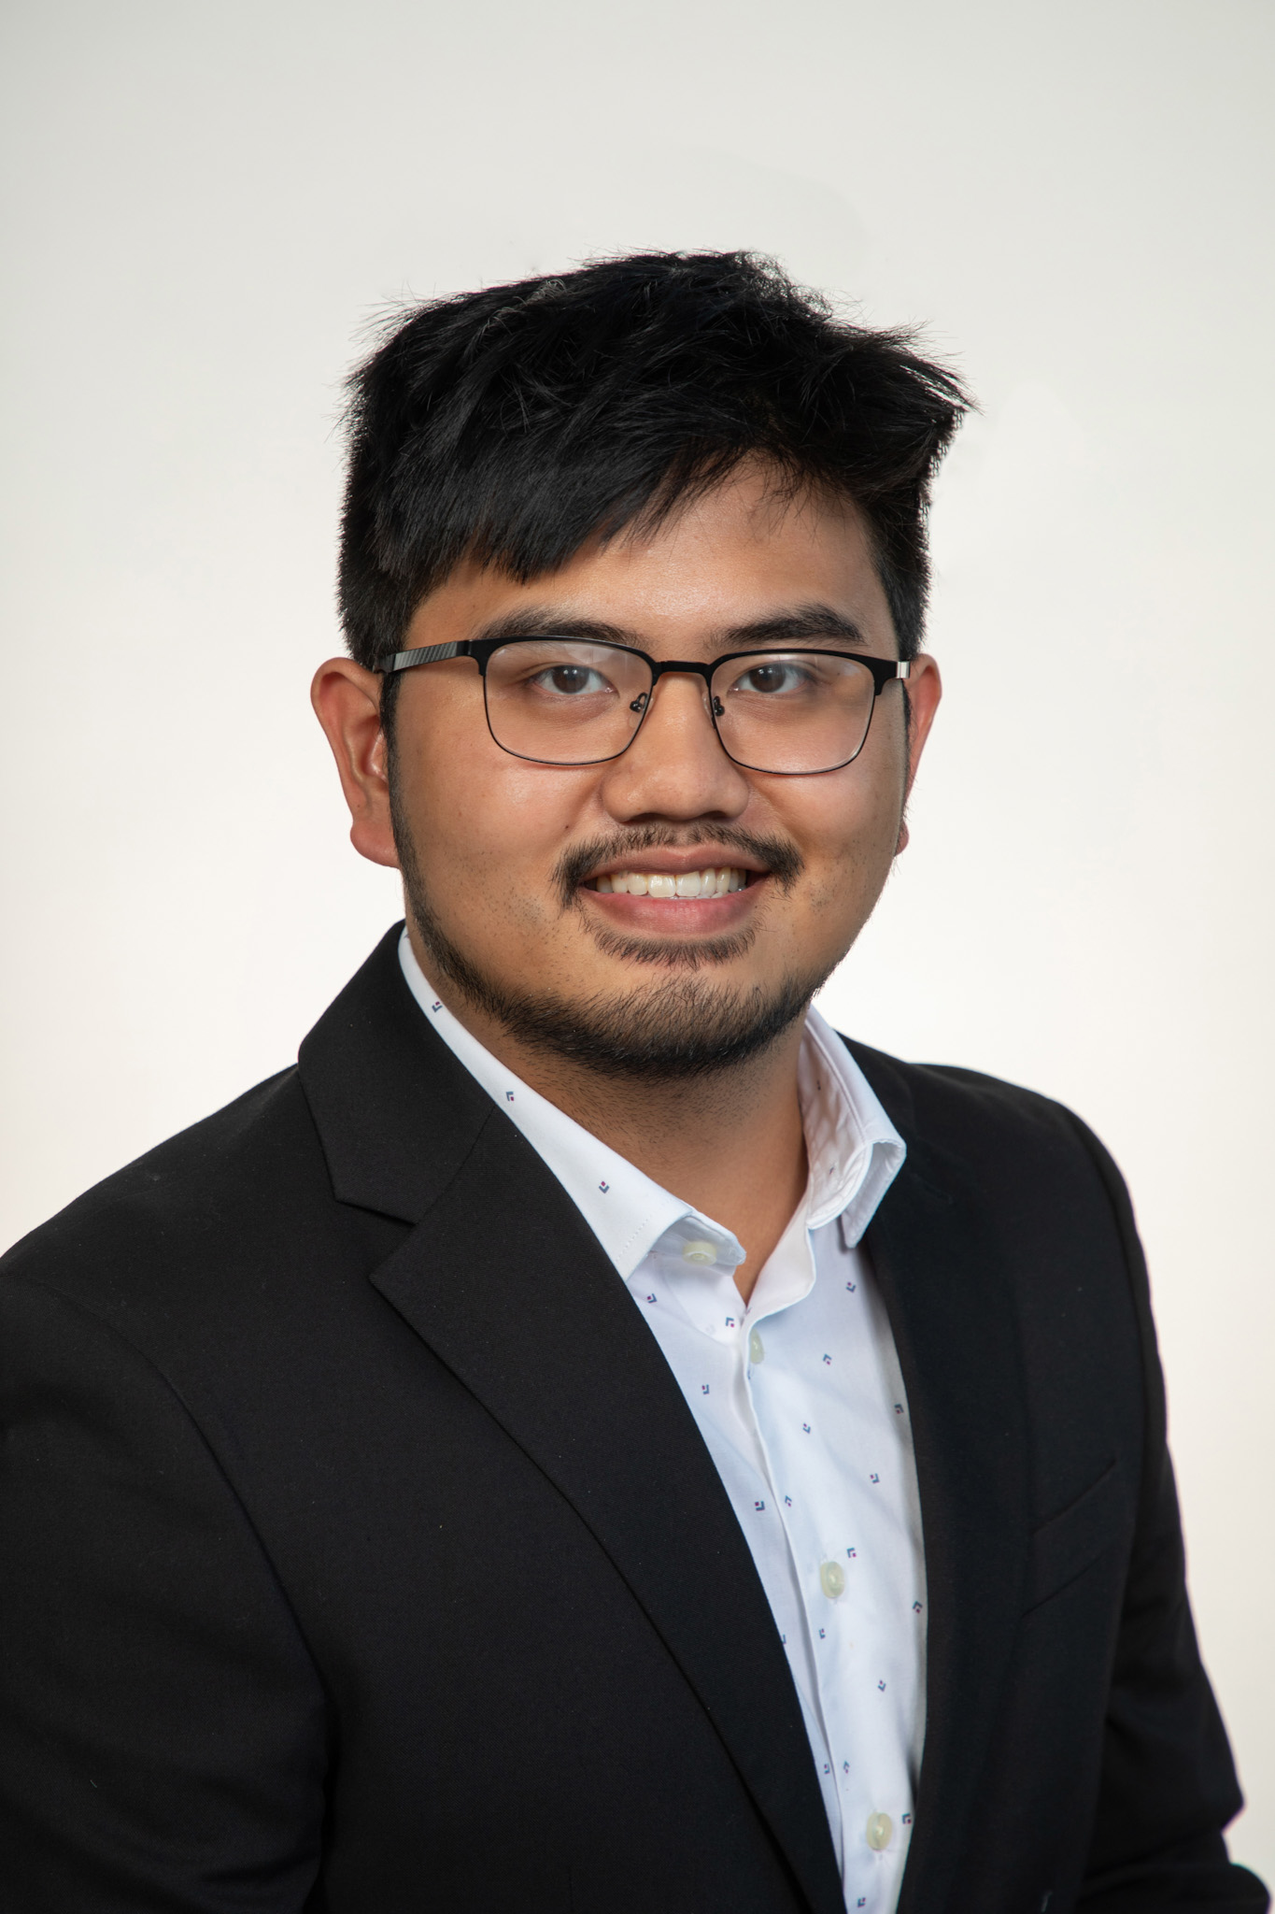
Team Introductions
Ja’Quan Young
Aaron Hastie
Fabrication
Engineer
Adam Imamura
Materials Engineer
Alex Soriano
Structural Engineer
Kyle Lozano
Design Engineer
Ja'Quan Young
Testing Engineer

Slide 3


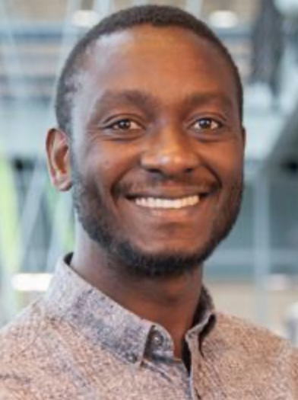
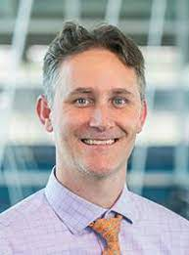
Sponsor and Advisor
Ja’Quan Young
Engineering Mentor
Dr. Moses Anubi, Ph.D.
Director of RASLab
Academic Advisor
Dr. Shayne McConomy, Ph.D.
Senior Design Professor

Slide 4
Project Scope
Ja’Quan Young
Notes:
Now that you have met the people behind this project allow me to give you the scope the team is focused on

Slide 5
Project Objective
Ja’Quan Young
The objective of this project is to design and fabricate a well-engineered 1/10th scale vehicle chassis that can house various autonomous driving components while taking into consideration clearly defined mechanical engineering metrics.
Notes:
The teams objective is to design and fabricate a 1/10th scale vehicle chassis capable of accommodating various autonomous driving components and adheres to specific mechanical engineering metrics

Slide 6

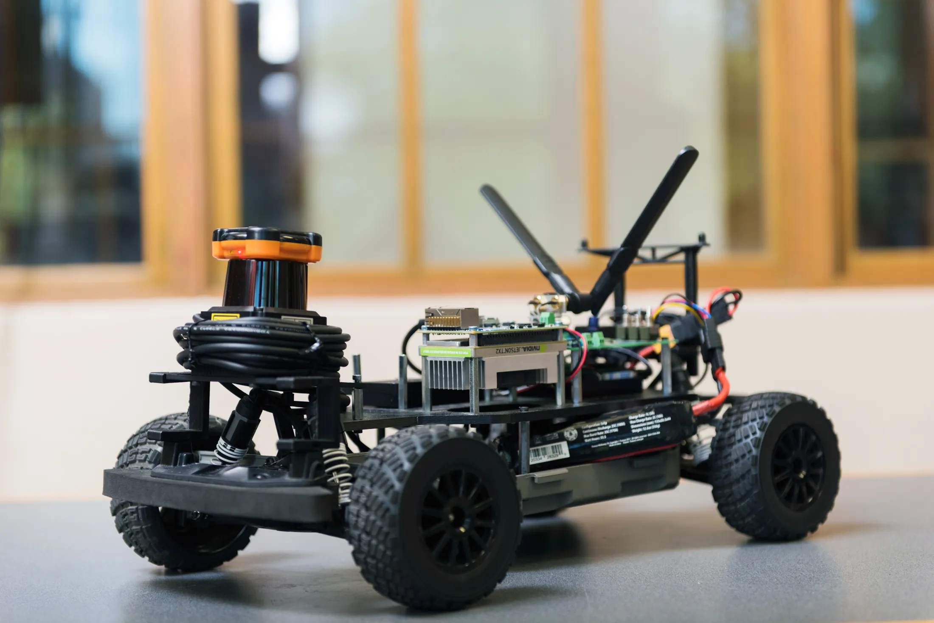
Project Background
Ja’Quan Young
Notes:
F1TENTH was originally founded at the University of Pennsylvania in 2016 and has since spread worldwide through institutions. F1TENTH has become a global initiative that promotes interest in autonomous systems through research, learning, and competition contributing to the growth and understanding of this field.

Slide 7
Key Goals
Ja'Quan Young
Design is Scalable.
Defined Mechanical Metrics.
Easily Replicated.
Notes:
The goals of the project consist of designing a chassis that is scalable. Although there is freedom of creativity, defined mechanical metrics are to be a result of this design. There being multiple vehicles in the RAS Lab, it is a goal to replicate this design for all of the other subjects.

Slide 8
Assumptions
Ja'Quan Young
Drive at high speeds in a competitive racing environment.
Used mainly by other engineers, such as students and researchers.
Computer Aided Design (CAD) model used in simulations.
Notes:
we will assume that the vehicles will reach high speeds which in turn indicates taking into consideration collisions and turning
As this vehicle is assumed to be used by engineers as opposed to the average consumer, there is lack of necessity for child proofing or simplicity of use.
The creation of a CAD model that can be easily used in simulation

Slide 9
Targets and Metrics
Ja’Quan Young
Notes:
Now moving on here are things we plan to validate later on in our timeline

Slide 10



Targets & Metrics
Ja’Quan Young
Movement
Utilization
Structure
Protection
Notes:
The following targets and metrics were created to be quantifiable goals for each of the functional systems to reach.

Slide 11
Targets & Metrics
Ja’Quan Young
Limits Body-Roll
±5 deg
Exceeds Max Turn Radius
±30 deg
Movement

Slide 12
Targets & Metrics
Ja’Quan Young
Limits Height
18 cm
Supports Weight of Components
12 N
Withstands Force from Crash
150 N
Structure

Slide 13
Targets & Metrics
Ja’Quan Young
Dampens Component Vibration
Ns/m
Rotation about all Axes
360 deg
Structure

Slide 14
Targets & Metrics
Ja’Quan Young
Accessible Input/Output Ports
5 cm
Utilization

Slide 15
Targets & Metrics
Ja’Quan Young
Protection Against Collison
150 N
Protection Against Roll-Over
20 Nm/Nm
Protection

Slide 16
Concept Generation
Aaron Hastie

Slide 17









High Fidelity #1
Aaron Hastie
Centralized Electronics Hub
Easy Accessibility
Facilitates Maintenance
Notes:
Centralized Electronics Hub Chassis that houses the computer, LiDAR, and other sensors for easy maintenance.

Slide 18

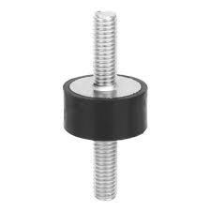

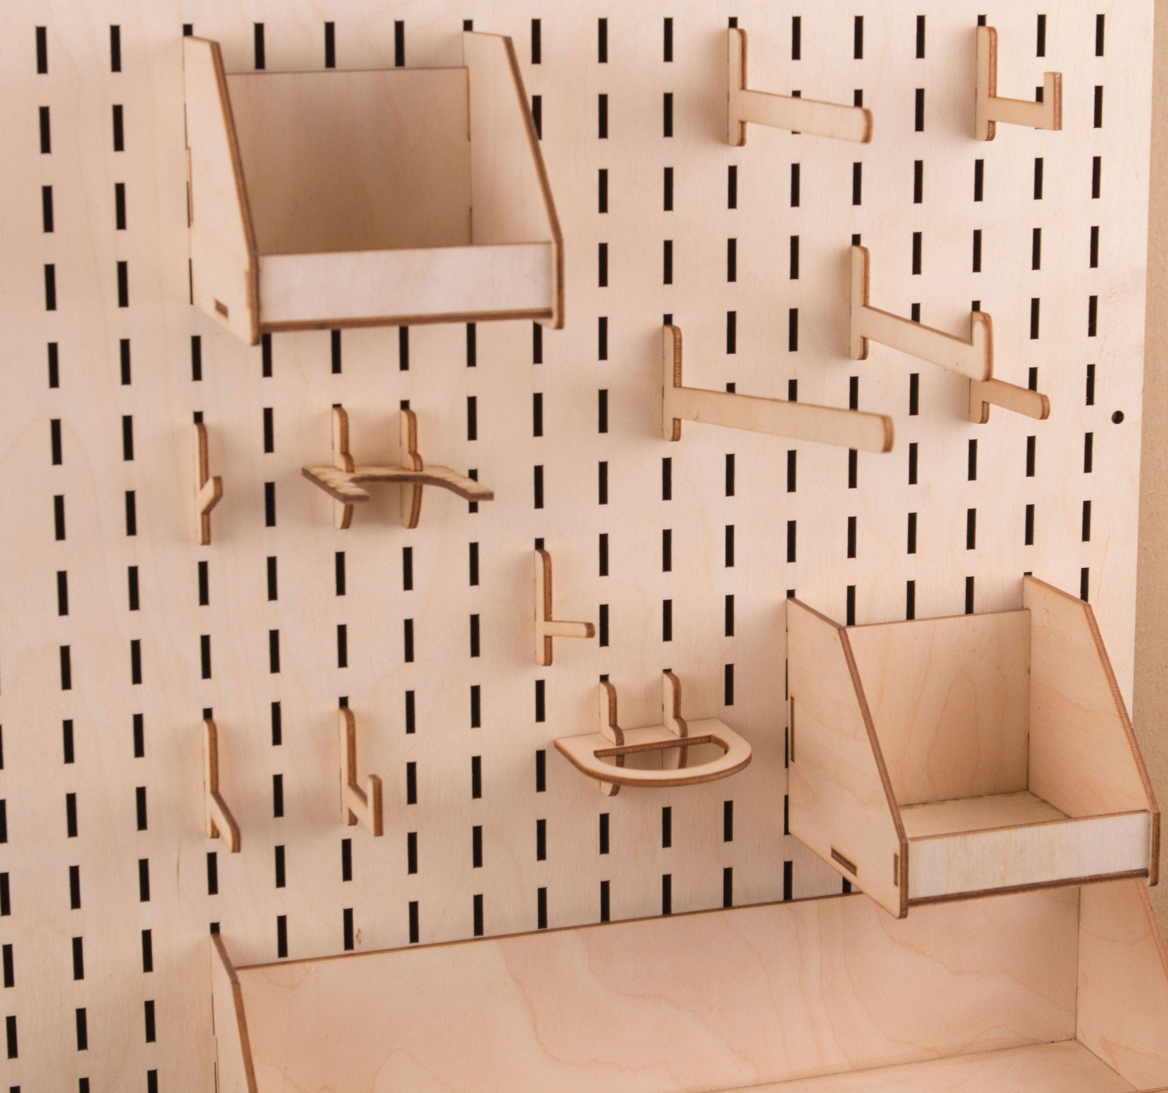
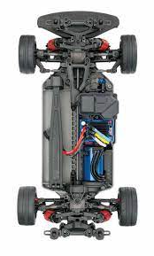

High Fidelity #2
Aaron Hastie
Function | Chassis Attachment | Modularity | Crash Protection | Vibration Damping | Body Roll Limitation
Solution | Screws | Uniform Mounting Holes | Pre-existing Subframe Bumpers | Dampening on Fasteners | Increased Spring Stiffness
Notes:
Screwed Down, Uniform Mounting Holes, Rely on Subframe Bumpers, Dampening on Fasteners, Increase Spring Stiffness.

Slide 19
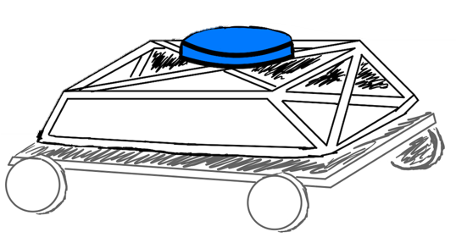

High Fidelity #3
Aaron Hastie
Roll Cage Chassis
Internal Cable Routing
High Rigidity
Lightweight
Notes:
Welded Chassis, Slot & Pin, Crash Detection and Avoidance/Protection, Cushioning, Bump Stops.

Slide 20
Concept Selection
Ja'Quan Young
Notes:
After reducing down to these 8 design concepts, the 5 medium and 3 high fidelity, we sent them through an iterative concept selection process.

Slide 21
Concept Selection
Ja'Quan Young
Pairwise Comparison
Pugh Chart
Analytical Hierarchy Process
House of Quality
Notes:
PC – determing the importance weight factor of each of our engineering characteristics
HoQ – we used those weight factors to ranking our engineering characteristics
Pugh – used to elimate concepts compared to a relatively neutral datum
AHP – used to help identify and eliminate bias as well as find our best alternative design

Slide 22
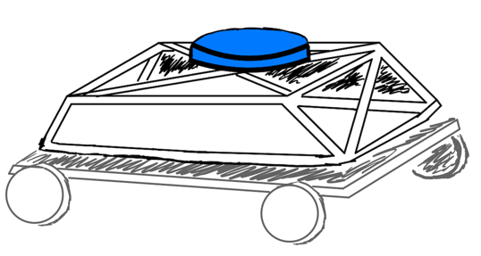
Final Selection
Ja'Quan Young
Roll Cage Chassis

Slide 23
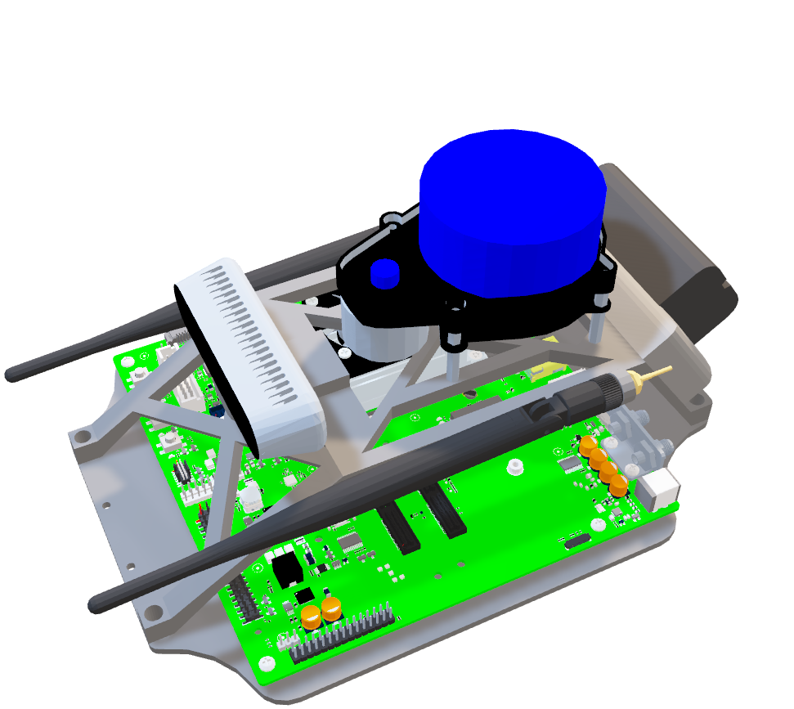
Final Design
Aaron Hastie
Adam Imamura

Slide 24

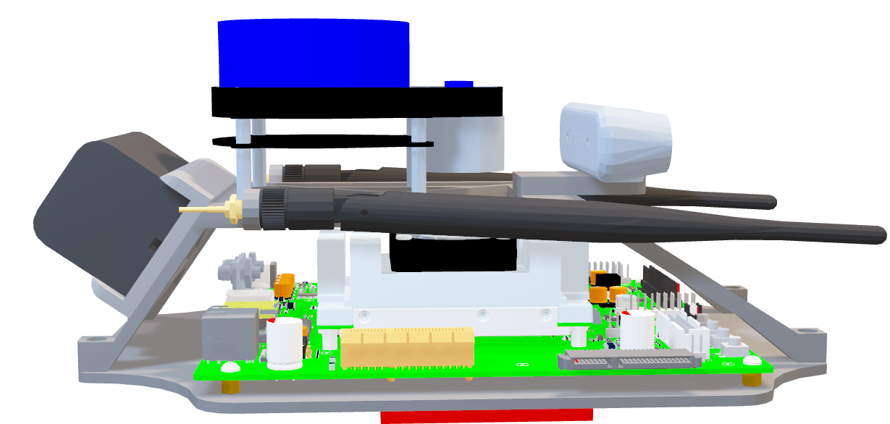
Battery
Aaron Hastie

Slide 25

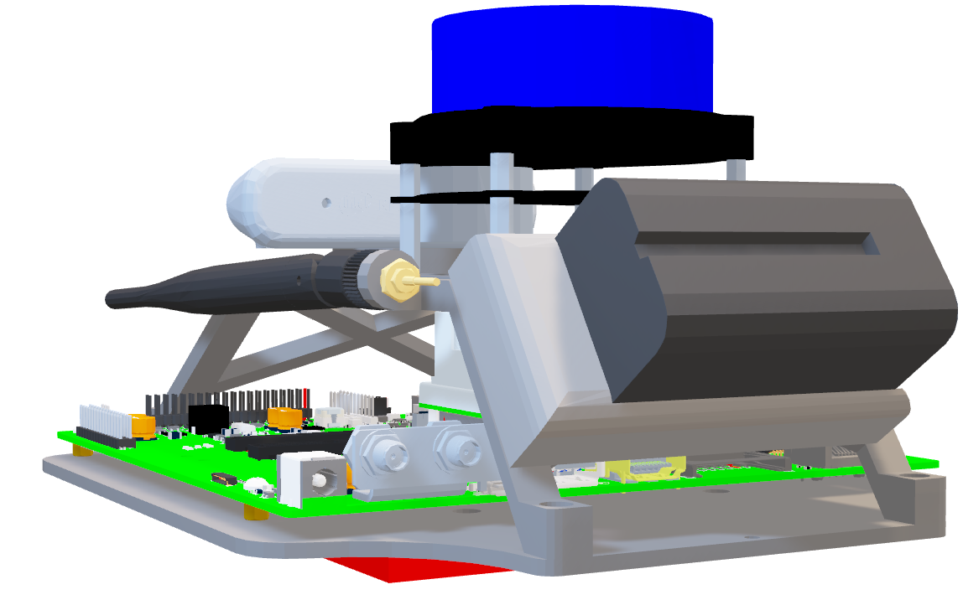
Battery
Aaron Hastie

Slide 26

Antenna
Aaron Hastie

Slide 27
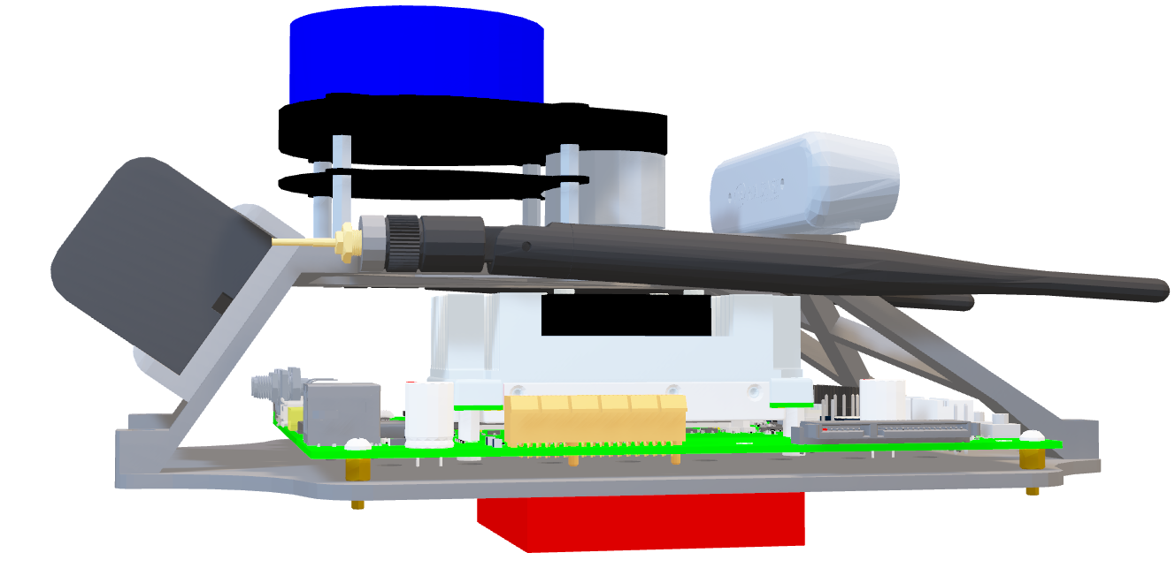
Antenna
Aaron Hastie

Slide 28
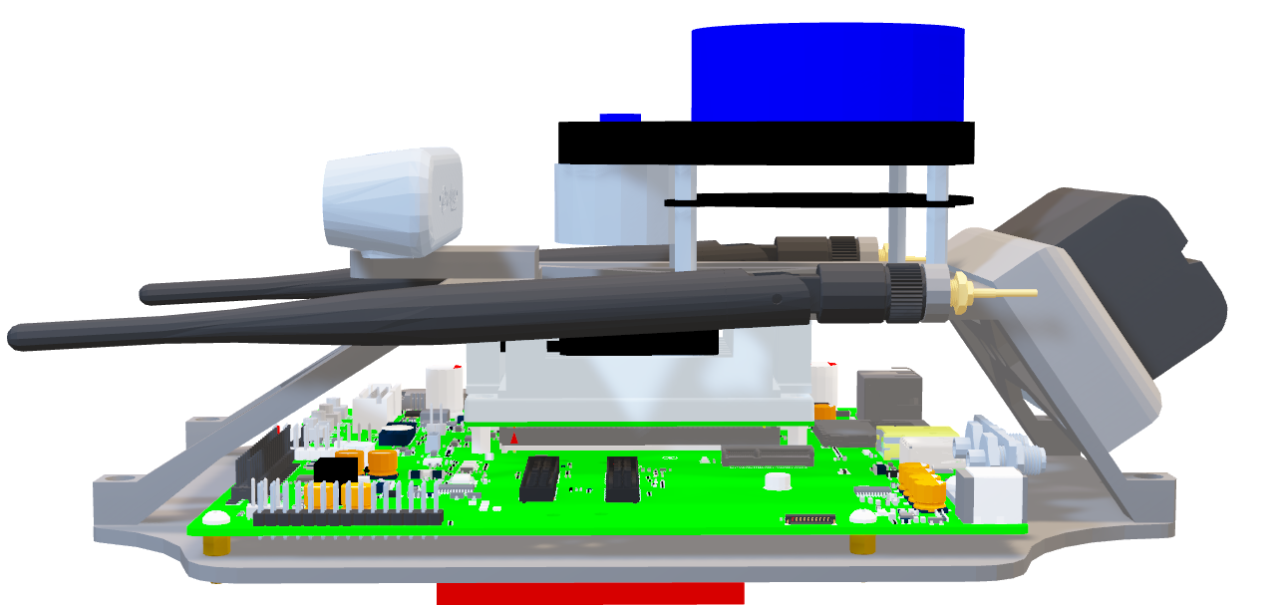
LiDAR
Aaron Hastie

Slide 29
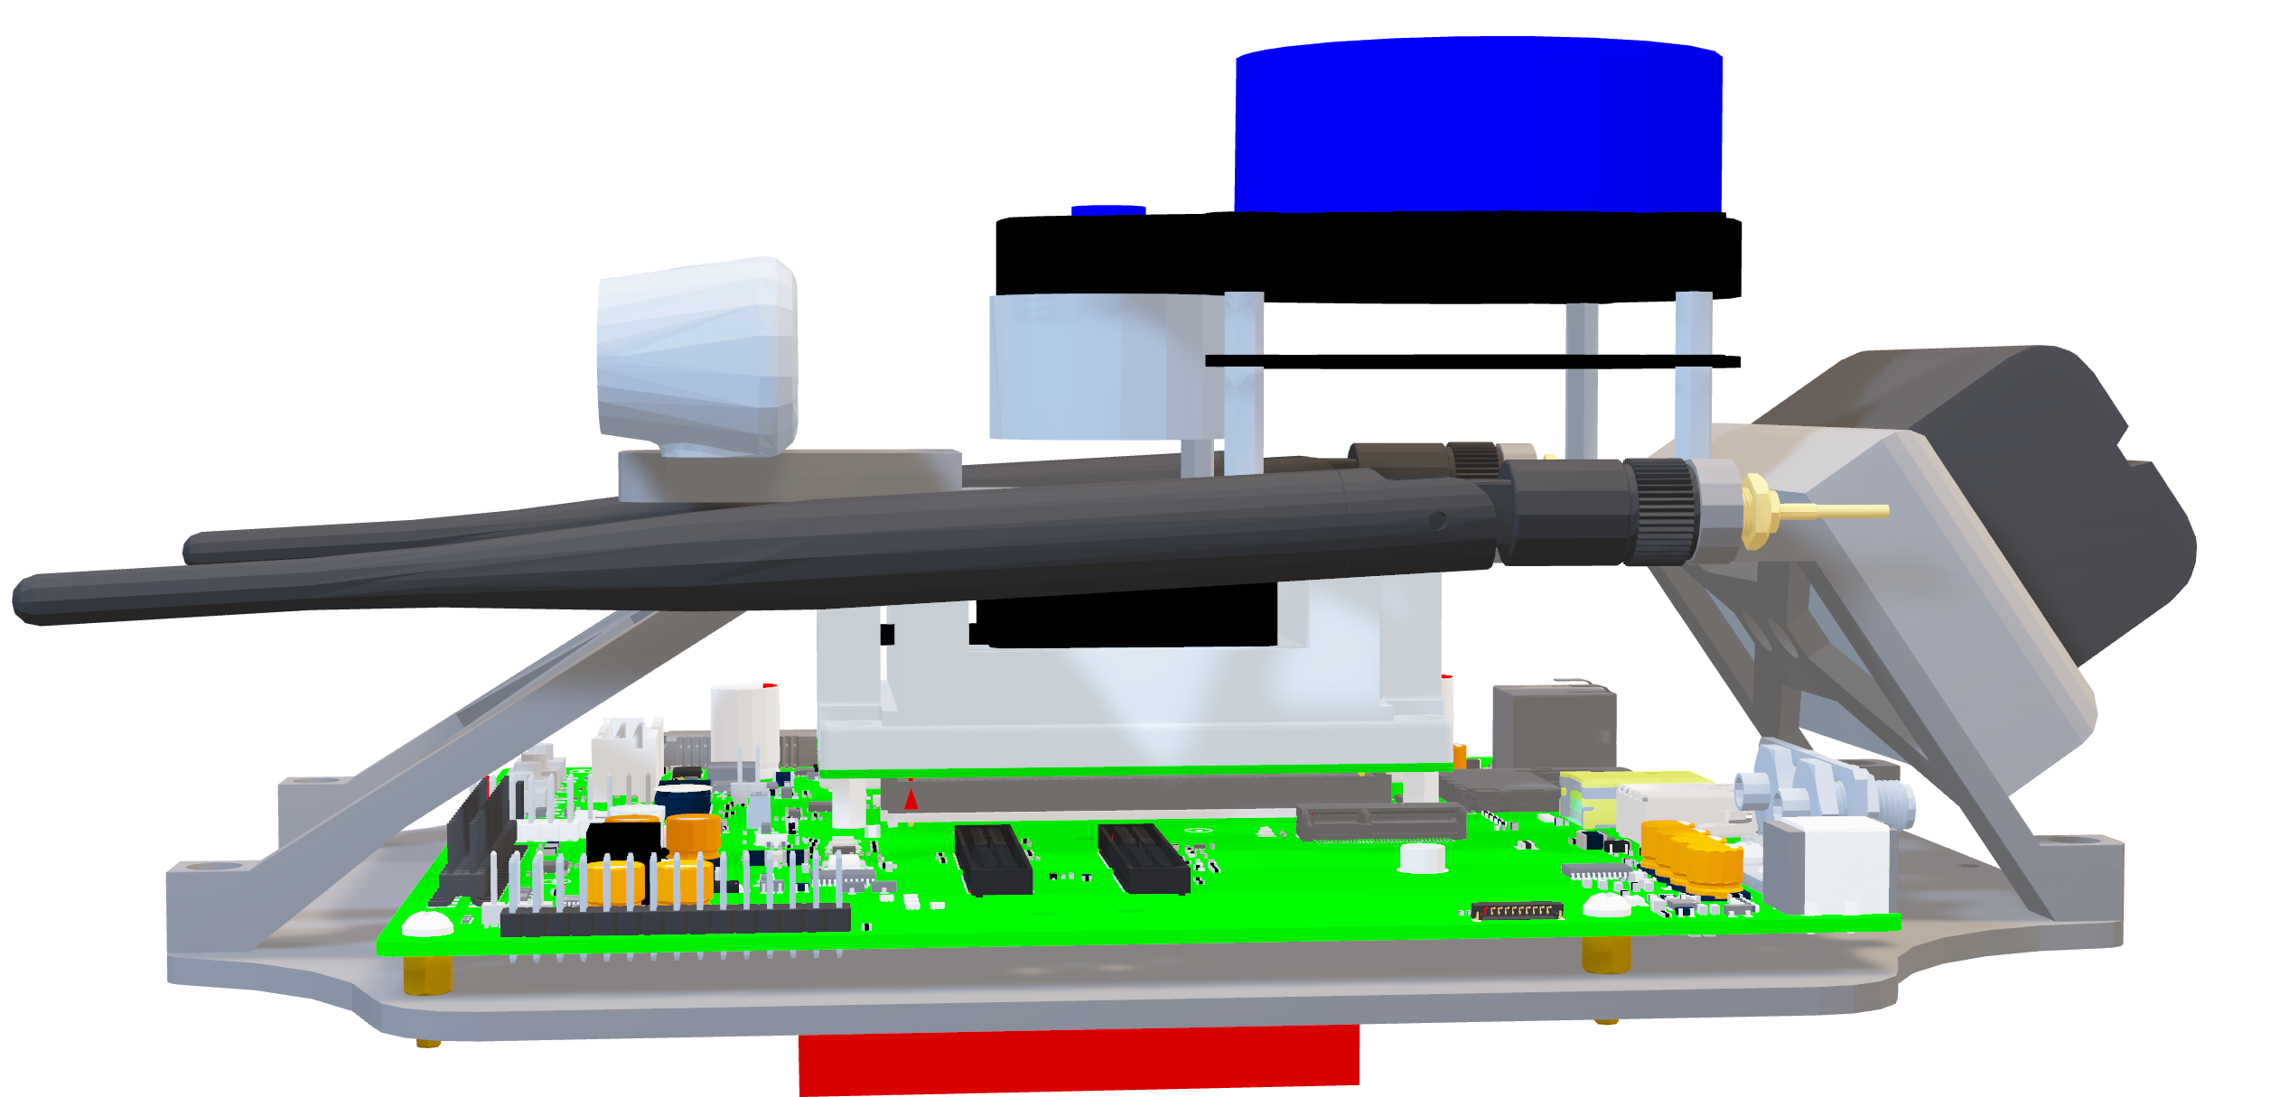
Stereo Camera
Aaron Hastie

Slide 30

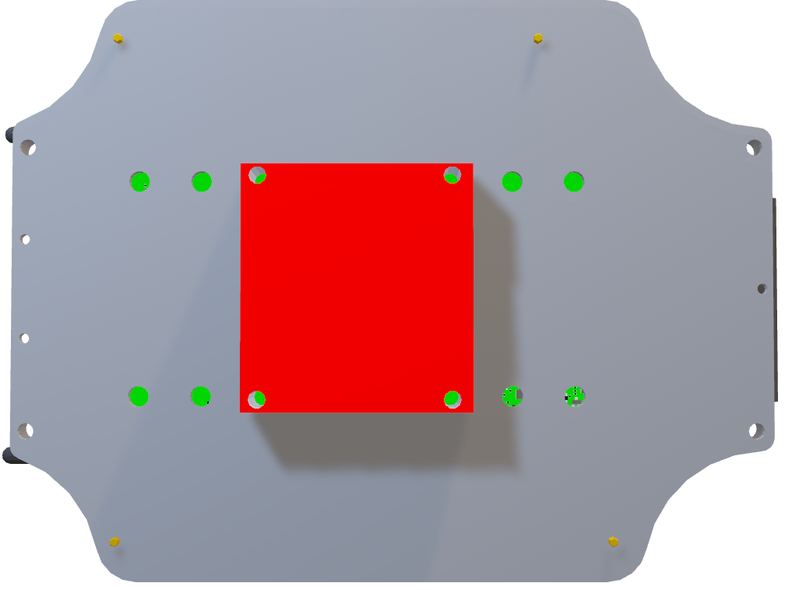
Speed Controller
Aaron Hastie

Slide 31
Timeline - January
Aaron Hastie
Finalize CAD Model
Finite Element Analysis
Iterate CAD Model

Slide 32
Timeline - February
Aaron Hastie
Rapid Prototyping
Update BoM
Manufacturing & Assembly

Slide 33
Future Work
Ja'Quan Young
Notes:
Here is what the team has for planned work in the coming weeks

Slide 34
Future Work
Ja'Quan Young
Begin procurement process
Submit parts to the machinist
Development of validation procedure
Running analyzations on CAD model
Web development

Slide 35
Questions?
Ja'Quan Young

Slide 36
Timeline - January
Aaron Hastie
January | Rapid Prototyping | Convert CAD to STL
 |  | Prepare 3D Printer
 |  | Assemble Prototype
January | Modify CAD Design | Review Design Requirements
 |  | Discuss Problem Areas
 |  | Refine CAD
January | Improved Prototype | Refine Model Based on Previous Error
 |  | Redesign Model if Needed
 |  | Simulate Loads
 |  | 3D print prototype
January | Test Prototype | Load Testing in X, Y, Z
 |  | Collision Test
 |  | Roll-Over Test
 |  | FEA Analysis
 |  | User-Handling Test

Slide 37
Timeline - February
Aaron Hastie
February | Update Bill of Materials | Determine Main Components
 |  | Vet vendors
 |  | Record Changes
 |  | Intitial Order
February | Finalize CAD Drawings | Create CAD Drawings
 |  | Annotate Dimensions
 |  | Create Part Numbers
 |  | Create CAD Assembly for Reference
 |  | Export to PDF
February | Machining and Fabrication | CAD files provided to Machine Shop
 |  | Provide Material to Machine Shop
 |  | Receive Status Update on Machined Parts
February | Assembly | Look over CAD Models
 |  | Examine Machined Parts
 |  | Put together all components

Slide 38

Concepts
Adam Imamura

Slide 39





Medium Fidelity
Aaron Hastie
Internal Cable Routing
Quick Release Shell
Recessed Camera Housing
Shifting Center of Mass
Screws
Magnets
Rigidity
Damping
Stiffer Spring
Notes:
Internal Cable Routing: A car that has cable chambers to organize cords, cables, and wires.
Image: Internal Cable Routing on Bicycle
Quick Release Shell: Quick Release Shell Chassis design for quick access and maintenance to internal components.
Image: Funny Car Body
Recessed Camera Housing: Recessed Camera Housing Chassis Design for camera protection.
Image: MLB “Front Row Camera” – Behind Home Plate
Shifting Center of Mass: Implement a moving mass inside the chassis to change the center of mass of the car. This allows the car to make tighter turns by keeping the force distribution on the inner and outer wheels closer to 50/50 during a turn.
[Morphological Chart] : Screwed Down, Magnetic Fasteners, Fully Rigid Construction, Damping on Fasteners, Increase Spring Stiffness. – IMO the increased spring stiffness OR the magnetic fasteners are most important here.

Slide 40
Concept Selection
Adam Imamura
Strong and Resilient
Defined Mechanical Metrics
Improved Vehicle Handling
Each Production is Identical
Ease of Access to Input & Output Ports and Battery
Pairwise Comparison

Slide 41
Concept Selection
Adam Imamura
House of Quality
Dampens Component Vibrations
Protects Against Roll-Over
Accessible I/O Ports
Limits Height
Influences Fluid About Body
Clears Maximum Turn Radius
Generates Downforce
Protects Against Collison

Slide 42
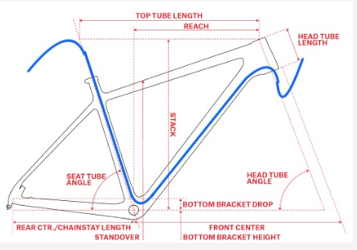
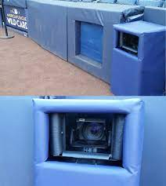
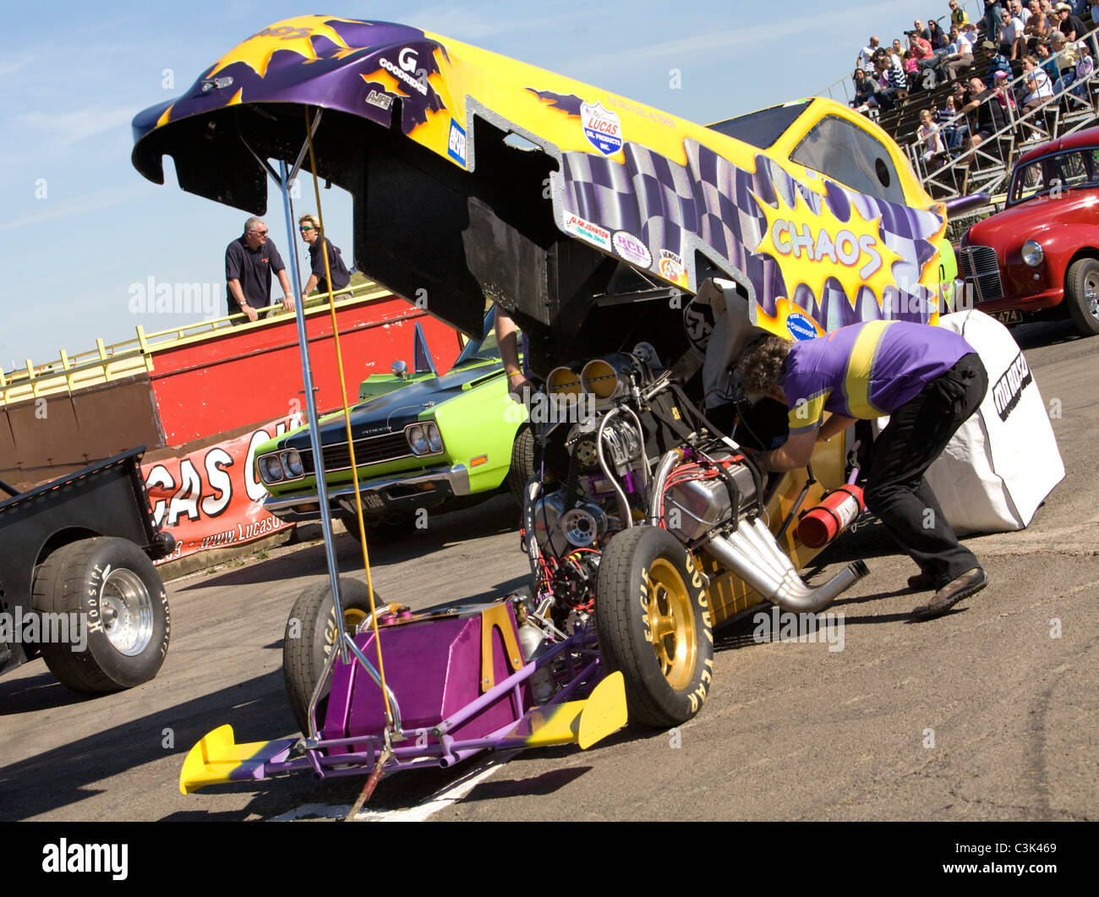

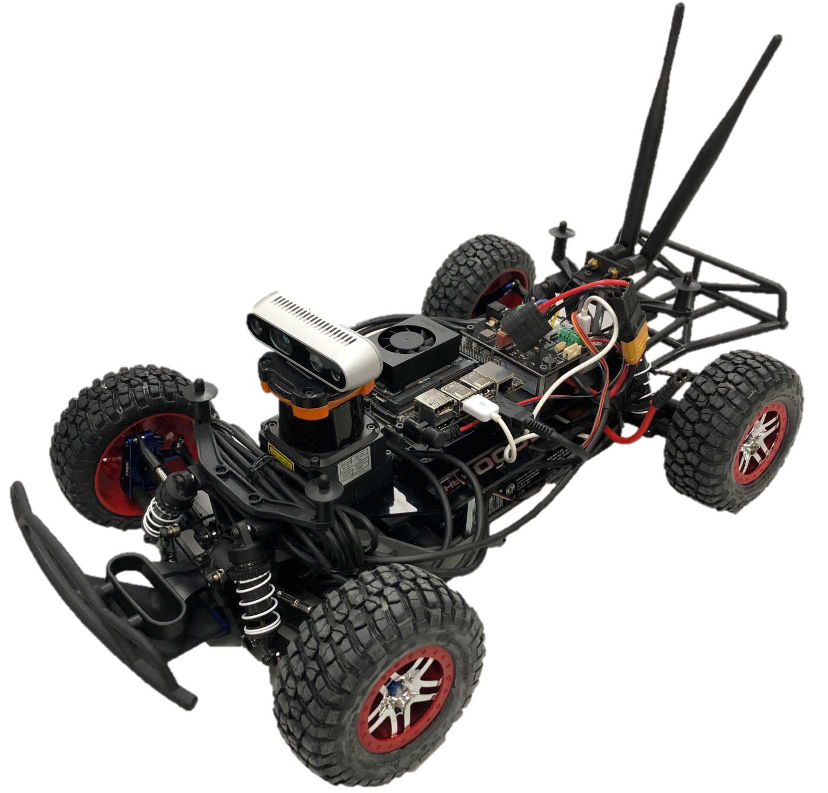
Concept Selection
Adam Imamura
Pugh Chart
Datum

Slide 43
Concept Selection
Adam Imamura
Pugh Chart
Recessed Camera Housing
Screws, Magnetic, Rigidity, Stiff Spring
Roll Cage

Slide 44

Concept Selection
Adam Imamura
Analytical Hierarchy Process

Slide 45
Backup Slides

Slide 46

Stakeholders
Alex Soriano
Resilient and Autonomous Systems Lab
Dr. Moses Anubi
Dr. Shayne
McConomy

Slide 47
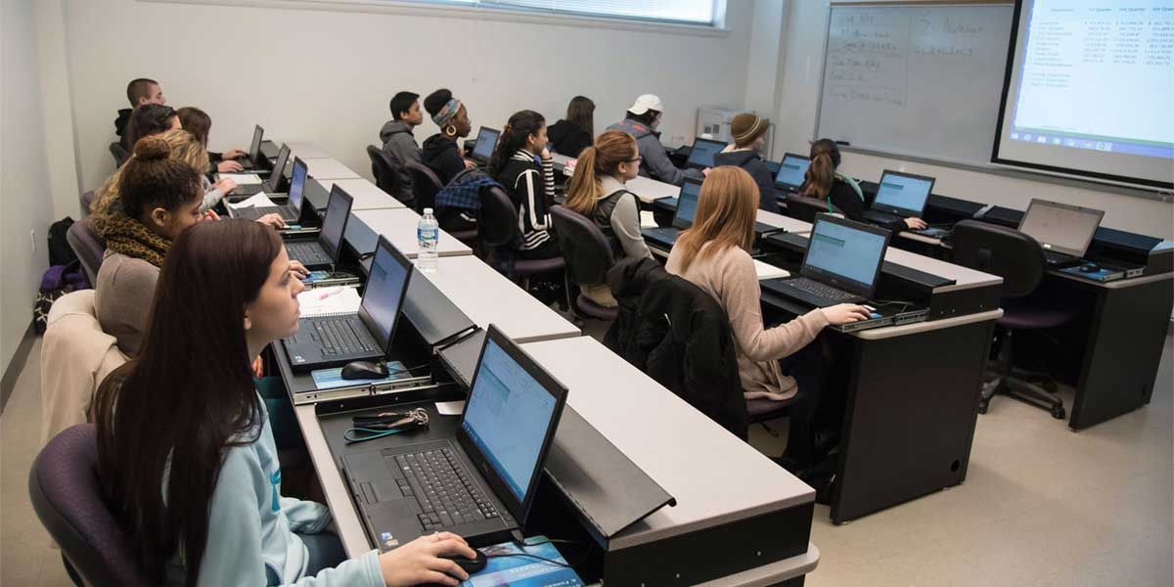
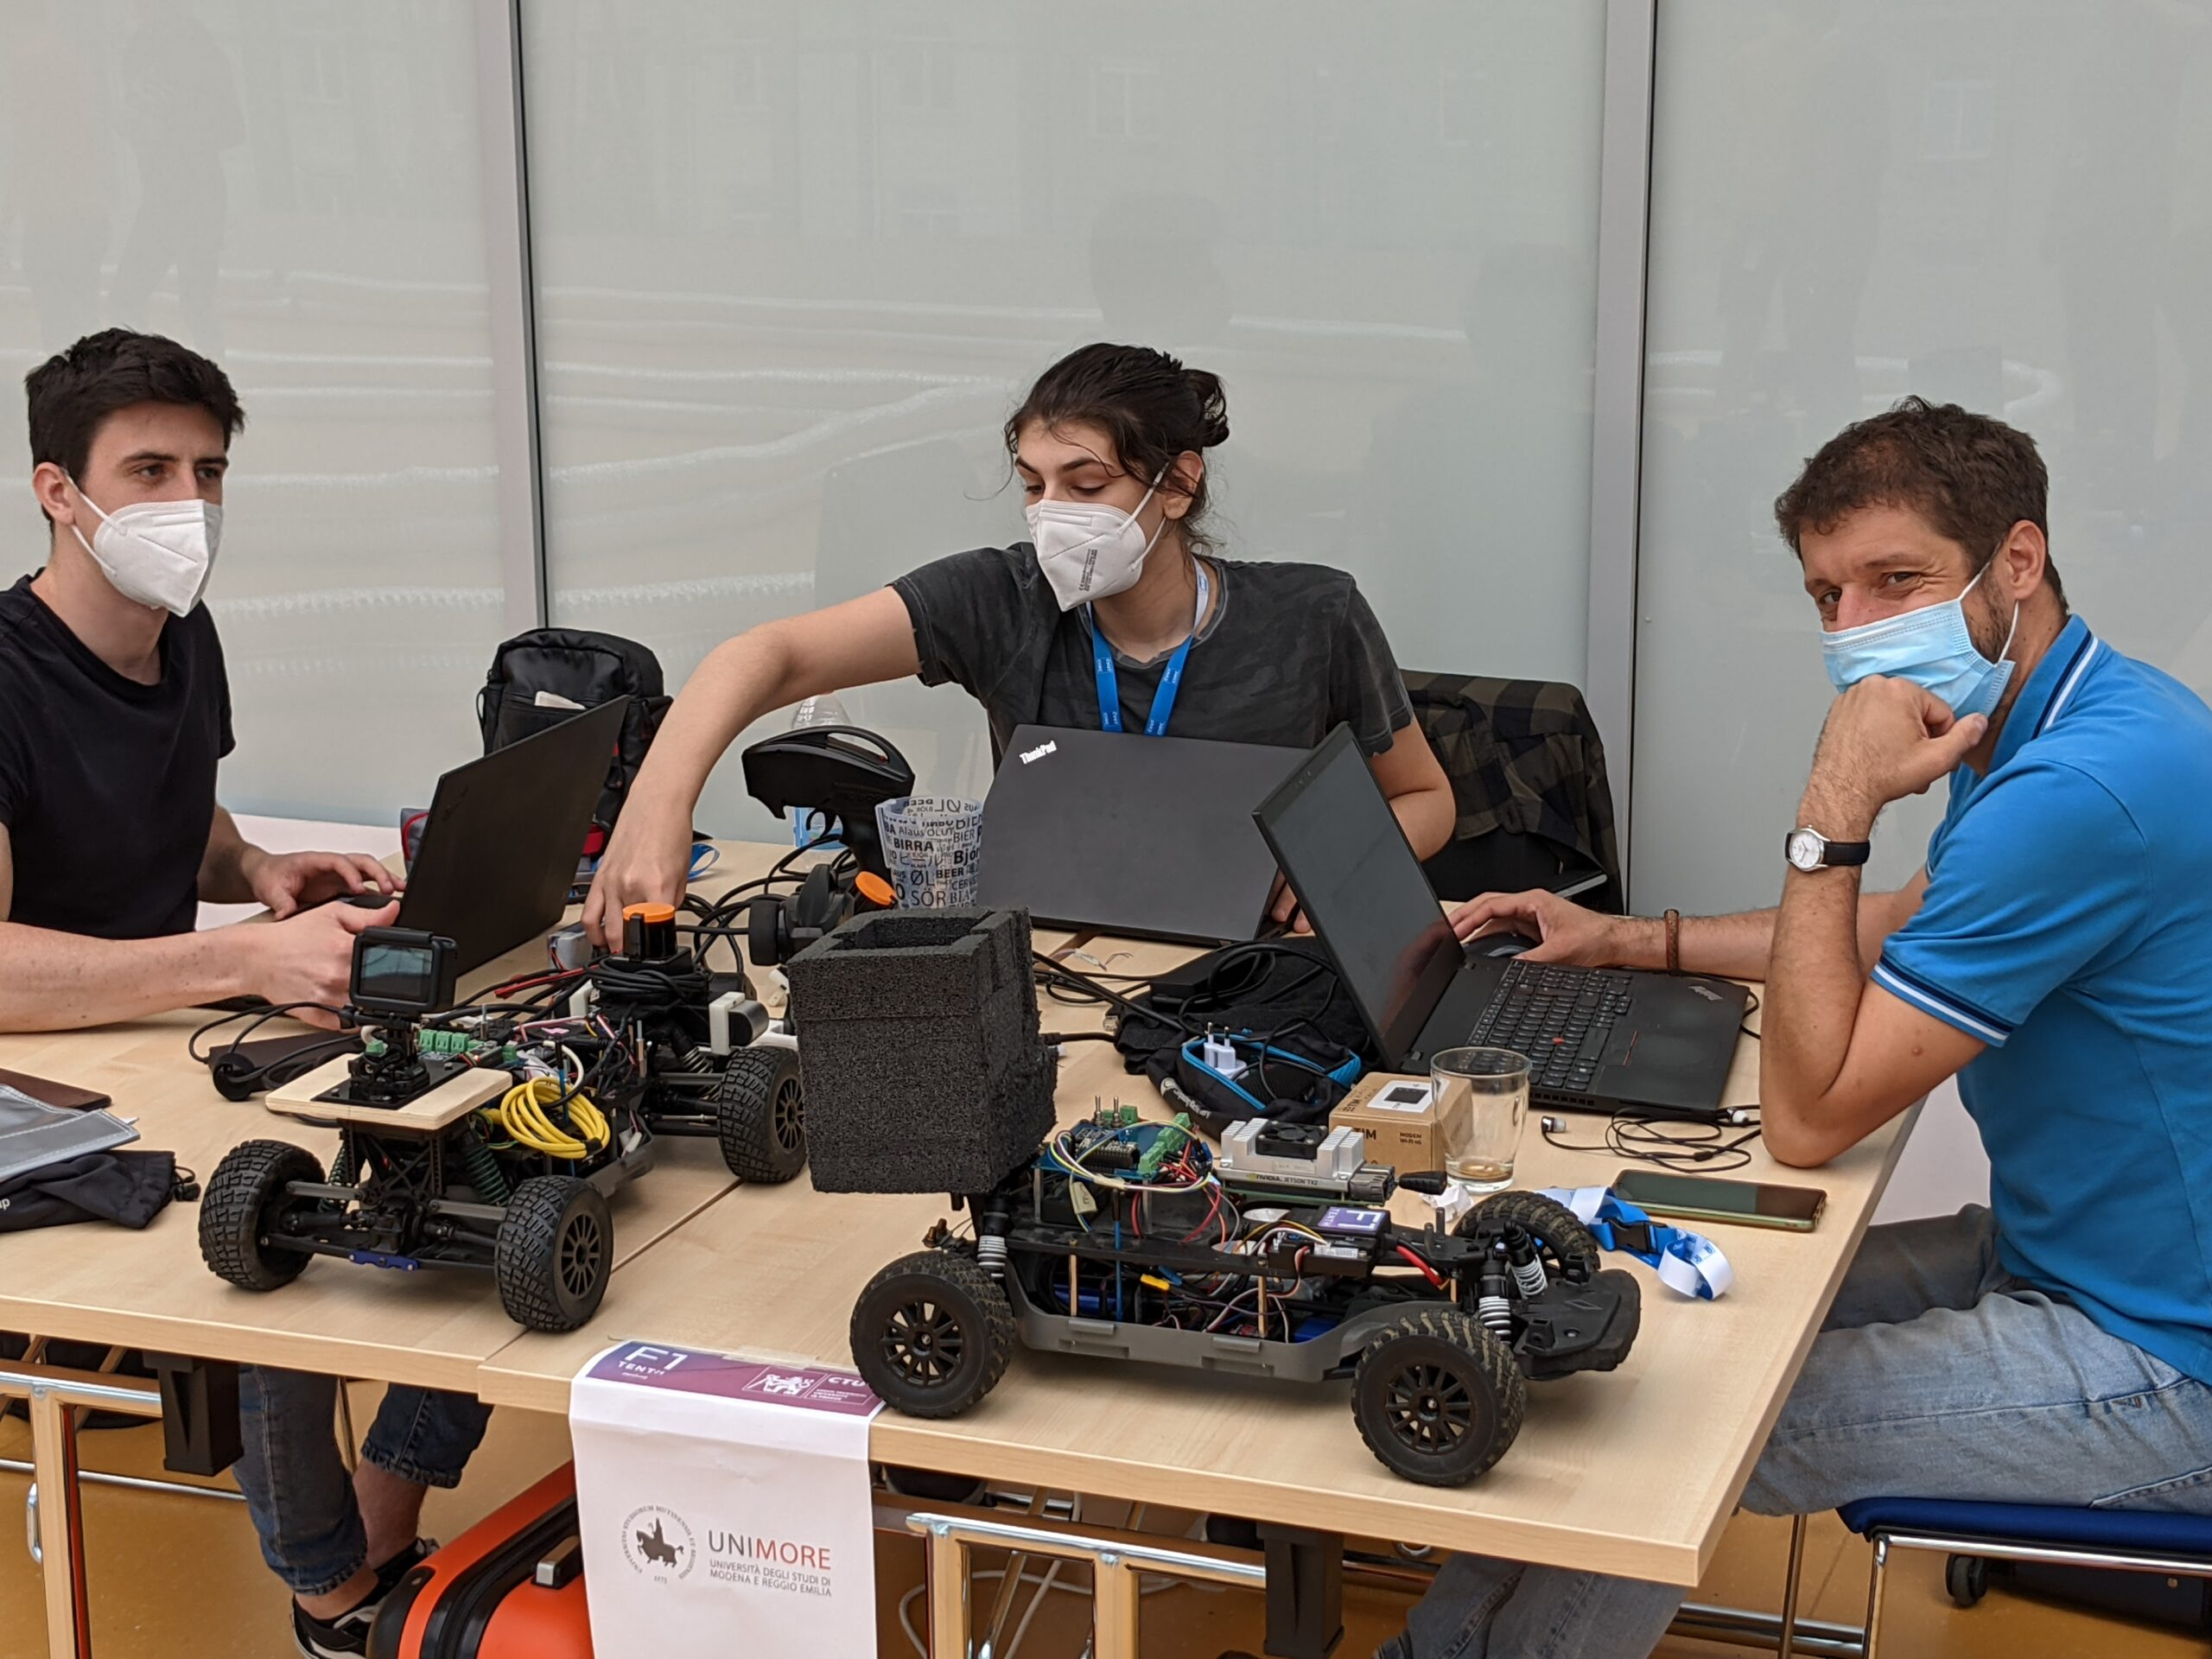
Target Markets
Alex Soriano
Primary Market
Secondary Market
Primary Market
Secondary Market

Slide 48
Customer Needs
Kyle Lozano

Slide 49
Overview
Kyle Lozano
Ask the Customer.
Record their Response.
Interpret their Need.

Slide 50
Chassis attachment - screws
Modularity - Uniform Mounting Holes
Crash Protection – Pre-existing Subframe bumpers
Vibration Damping – Damping on fasteners
Body Roll limitation - Increased Spring Stiffness

Slide 51
Kyle Lozano
Question | Response | Interpreted Need
What are the goals for this project? | “The designed mechanical properties such as Moment of Inertia and Center of Mass should be consistent across different chassis. Variation in length is undesirable. The design should be easily scalable.” | The F1/10th vehicle chassis has clearly defined mechanical metrics and is easily reproducible.
Mechanical Metric | Value
Center of Gravity | TBD
Center of Mass | TBD
Gross Weight | TBD
Weight Distribution | TBD Front/TBD Rear

Slide 52
Kyle Lozano
Question | Response | Interpreted Need
What kind of extra components or attachments need to be considered? | “Expect the chassis components to remain the same.” | All iterations of the chassis will contain the same components.
Version 1
Version 2
Version …

Slide 53
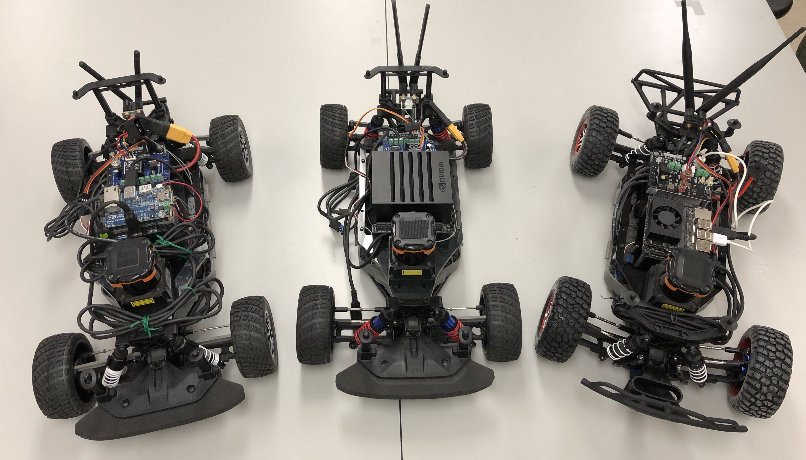
Kyle Lozano
Question | Response | Interpreted Need
What do you like about the chassis so far? | “The ability to fully control the design of the platform is great.” | The design of the chassis is unique and can be modified to suit the potentially changing needs of the customer.

Slide 54
Kyle Lozano
Question | Response | Interpreted Need
What do you dislike about the chassis so far? | “The existing chassis’ are not identical. Control simulations are not able to be transferred simply between different chassis’ easily.” | Designs produced will allow for repeatable results.

Slide 55
Functional Decomposition
Kyle Lozano

Slide 56
Functional Decomposition Hierarchy
Kyle Lozano
F1TENTH Chassis
Movement
Structure
Utilization
Protection

Slide 57
Movement Subsystem
Kyle Lozano
F1TENTH Chassis
Movement
Structure
Utilization
Protection
Suspension
Steering
Dampens Vibrations
Clears Ground
Clears Maximum Turn Radius
Limits Body Roll

Slide 58
Structure Subsystem
Kyle Lozano
F1TENTH Chassis
Movement
Structure
Utilization
Protection
Compact
Aerodynamic
Material
Vibration
Fixed
Conceals Secondary Components
Contains Cables
Influences Fluid about Body
Utilizes Free Space
Limits Length, Width, and Height
Generates Downforce
Supports Weight of Components
Withstands Forces form Crashes
Dampens Component Vibrations
Fixes Components to Chassis
Allows for Rotation about All Axes

Slide 59
Structure Subsystem Breakdown
Kyle Lozano
Structure
Compact
Aerodynamic
Material
Vibration
Fixed

Slide 60
Structure Subsystem: Compact
Kyle Lozano
F1TENTH Chassis
Movement
Structure
Utilization
Protection
Compact
Aerodynamic
Material
Vibration
Fixed
Conceals Secondary Components
Contains Cables
Utilizes Free Space
Limits Length, Width, and Height

Slide 61
Structure Subsystem: Aerodynamic
Kyle Lozano
F1TENTH Chassis
Movement
Structure
Utilization
Protection
Compact
Aerodynamic
Material
Vibration
Fixed
Influences Fluid about Body
Generates Downforce

Slide 62
Structure Subsystem: Material
Kyle Lozano
F1TENTH Chassis
Movement
Structure
Utilization
Protection
Compact
Aerodynamic
Material
Vibration
Fixed
Supports Weight of Components
Withstands Forces form Crashes

Slide 63
Structure Subsystem: Vibration
Kyle Lozano
F1TENTH Chassis
Movement
Structure
Utilization
Protection
Compact
Aerodynamic
Material
Vibration
Fixed
Dampens Component Vibrations

Slide 64
Structure Subsystem: Fixed
Kyle Lozano
F1TENTH Chassis
Movement
Structure
Utilization
Protection
Compact
Aerodynamic
Material
Vibration
Fixed
Fixes Components to Chassis
Allows for Rotation about All Axes

Slide 65
Utilization Subsystem
Kyle Lozano
F1TENTH Chassis
Movement
Structure
Utilization
Protection
Access
Components
Allows for Easily Accessible Input/Output Ports
Allows for Components to be Used as Intended

Slide 66
Protection Subsystem
Kyle Lozano
F1TENTH Chassis
Movement
Structure
Utilization
Protection
Crash
User Handling
Protects Against Collisions
Protects against Roll-Over
Protects User from Sharp Extrusions or High Voltages

Slide 68
Project Background
Project F1TENTH is a developing field of autonomous systems by utilizing a preexisting 1/10th scale RC chassis for a competition-based race.
Originally founded by the University of Pennsylvania in 2016.
  The project has expanded to various researchers, engineers, and enthusiasts.
The purpose of this project is to develop our own iteration of an F1TENTH vehicle for researchers and students.
  Primarily made for autonomous algorithms and providing them with a robust and engineered platform for implementation.

Slide 69
Stakeholders
F1 TENTH
Locomotion (F1TENTH Partnering Company)
FAMU-FSU College of Engineering
Senior Design Coordinator
  Dr. Shayne McConomy
Academic Advisor
  Dr. Moses Anubi

Slide 70
Assumptions
Repeatable results with implementation on multiple chassis
  Without performance variation.
Vehicle body is modular and separate body portions will be able to be replaced.
Minimizing mass as much as possible.
The current design of the vehicle chassis is not expected to change,
  All designs will be made for a single chassis that may be duplicated.
Cars will drive at high speeds, prone to abuse in a racing environment.

Slide 71
Markets
Primary Markets
Secondary Markets
Resilient and Autonomous Lab at Florida State University
  Dr. Anubi – Used as a research tool.
Students in autonomous vehicle courses.
F1/10th Open-Source Project Consumers.
  Access the development of these F1TENTH cars.
Hobbyists Interested in F1TENTH.
Remote Control Car Community.

Slide 72
Interpreted Need
The F1/10th vehicle chassis has definite mechanical metrics and is easily reproducible.
The design of the chassis will be constructed in a timely manner.
All iterations of the chassis will contain the same components.
The design of the chassis is unique and modular.
Designs produced will bear repeatable results.
Iterative design will be necessary during this project. Excessive iterations may be counterproductive.
The final design may be inspired by other effective designs. The function of the body will be more important than the form.
The design will be simple yet effective.
The project may be referenced with a current chassis design or from scratch.
The current build for the car is effective.
The car will have a fixed chassis with accessible and replaceable components.
The final product will feature a plug-and-play design.
The chassis will withstand crashes and be practical while the vehicle is in motion.
The final product may be utilized in competition and teaching settings.
Power supply and onboard computer may have higher accessibility.

Slide 73
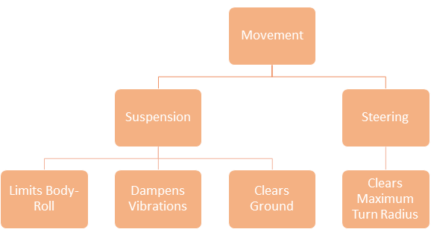
Movement
F1TENTH Chassis
Movement
Structure
Utilization
Protection

Slide 74
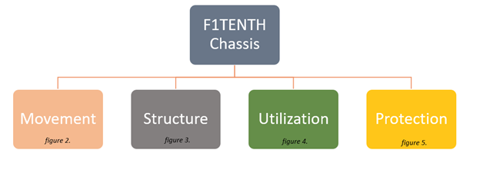
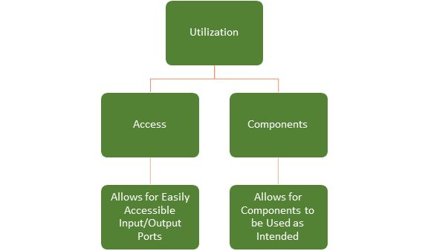
Utilization

Slide 75
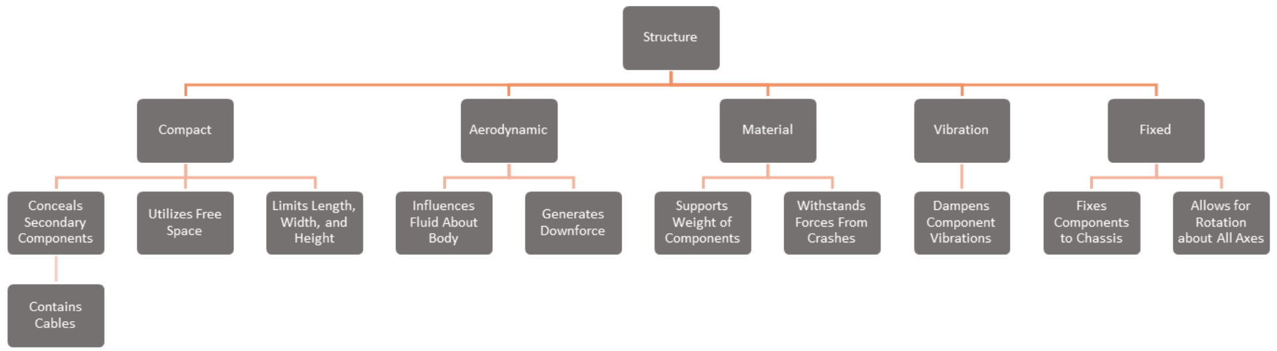
Structure

Slide 76
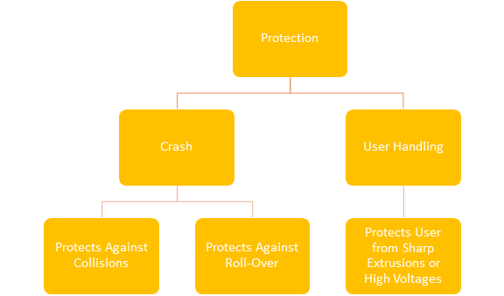
Protection

Slide 77
Kyle Lozano
Question | Response | Interpreted Need
What problems do you experience commonly with this type of project? | Time. It seems to take too long. It would be great if you can get it done in a timely manner. | The design of the chassis will be constructed in a timely manner.

Slide 78
Question | Response | Interpreted Need
What kind of different iterations would you like to see? | Many design iterations may not be reasonable under the time restraints present, but worthwhile, well-engineered iterations will be expected. | Iterative design will be necessary during this project. Excessive iterations may be counterproductive.
Is it fair game to reference competitor’s cars or from any vehicle features you want? | Prefers well engineered solutions to aesthetic design. F1 car designs are great to draw from, well-engineered with years of Research and Development behind them. | The final design may be inspired by other effective designs. The function of the body will be more important than the form.
What are some featuring the car should have in the final design? | No fancy features. Just the simplest working design. | The design will be simple yet effective.
Would you prefer we work off the current chassis design or start completely from scratch? | I don’t have a preference on this. Anything you like is fine. | The project may be referenced with a current chassis design or from scratch.
What do you see in other F1TENTH builds that you would like us to implement? | Nothing really. I think the building we have now may be good. Select one that works best according to your criteria. | The current build for the car is effective.

Slide 79
Question | Response | Interpreted Need
How modular would you like the car to be? | A fixed chassis with easily replaceable components. | The car will have a fixed chassis with accessible and replaceable components.
Would you like the final product to be plug-and-play or assembly based? | Plug-and-play. | The final product will feature a plug-and-play design.
What extreme loading cases will the chassis need to withstand? | Crashes, top speed, cornering/accelerating/braking forces, transport. | The chassis will withstand crashes and be practical while the vehicle is in motion.
What setting will these cars be used in? | Competition and teaching settings. | The final product may be utilized in competition and teaching settings.
What components need to be accessed most frequently? | Batteries and the onboard computer. | Power supply and onboard computer may have higher accessibility.

Slide 80
Overview
Kyle Lozano
Questions were asked during the first meeting, and with follow-up questions in the form of an email.
Responses from our advisor were changed to interpreted needs.
Interpreted needs will help our design parameters as well as set the base foundation of the project.

Slide 81
Concepts
Adam Imamura

Slide 82
Concepts
Adam Imamura

Slide 83
Concepts
Adam Imamura

Slide 84
Concepts
Adam Imamura

Slide 85
Concepts
Adam Imamura

Slide 86
Concepts
Adam Imamura

Slide 87
Concepts
Adam Imamura

Slide 88
Concepts
Adam Imamura

Slide 89
Concepts
Adam Imamura

Slide 90
This is 10-point
This is 15–point Times
This is 20–point
This is 25–point
This is 30–point
This is 35–point
This is 40–point
This is 50–point
This is 60–point
This is 72–point
Notes:
Use at least 20-point font in Room A105, B134, and B136
Use at least 25-point font in Room B135

Slide 91
College of Engineering Color Palette
1 2 3 4
Pantone: PMS 195 C
RGB: 120, 47, 64
Hex: #782F40
CMYK:19, 90, 50, 55
1 2 3 4
Pantone: Black C
RGB: 0, 0, 0
Hex: #000000
CMYK:0, 0, 0, 100
Garnet
Black
1 2 3 4
RGB: 238, 118, 36
Hex: #EE7624
CMYK:2, 66, 99, 0
1 2 3 4
Pantone: PMS 000C
RGB: 255, 255, 255
Hex: #FFFFFF
CMYK: 0, 0, 0, 0
Fang
Orange
White
Notes:
Avoid 75% Black in B135

Slide 92
Accent Color Palette
1 2 3 4
RGB: 0, 59, 111
Hex: #003B6F
CMYK:
1 2 3 4
RGB: 0, 59, 111
Hex: #003B6F
CMYK:
1 2 3 4
RGB: 251, 236, 93
Hex: #FBEC5D
CMYK:
1 2 3 4
RGB: 219, 215, 210
Hex: #DBD7D2
CMYK:
1 2 3 4
RGB: 251, 236, 93
Hex: #FBEC5D
CMYK:
1 2 3 4
RGB: 219, 215, 210
Hex: #DBD7D2
CMYK:
Tardis Blue
Tardis Blue
Corn
Timberwolf
Corn
Timberwolf
1 2 3 4
RGB: 206, 0, 88
Hex: #CE0058
CMYK: 0, 100, 43, 12
1 2 3 4
RGB: 206, 0, 88
Hex: #CE0058
CMYK: 0, 100, 43, 12
1 2 3 4
RGB: 104, 40, 96
Hex: #682860
CMYK:
1 2 3 4
RGB: 220, 220, 220
Hex: #DCDCDC
CMYK:
Rubine Red
Rubine Red
Imperial
Gainsboro
1 2 3 4
RGB: 72, 146, 155
Hex: #48929b
CMYK:
1 2 3 4
RGB: 64, 224, 208
Hex: #40E0D0
CMYK:
1 2 3 4
RGB: 255, 139, 0
Hex: #FF8B00
CMYK:
Asagi-iro
Turquoise
American Orange
Notes:
Remove American orange add hyperlink grey
Make corn the last for b135
All work in 134 imperial move later
Tardis doesn’t work in b136

Slide 93
F7AB19
D67F15
EE7624
D64615
F73119
Analogous
https://color.adobe.com/create/color-wheel
6E3610
F0A16C
EE7624
6E4931
BASB1C
Monochromatic
A14508
4BED3B
EE7624
250CED
2010A1
Triad
A1470C
FF8C40
EE7624
0098A1
24E2ED
Complementary
28A164
2FED8D
EE7624
0848A1
1871ED
Split Complementary
EDAC2F
3BED93
EE7624
0C6AED
ED2F18
Double Split Complementary
ED660C
C7ED3B
EE7624
0CE1ED
A418ED
Square
BA7E09
87724A
EE7624
60EFCF
09BA61
Compound
AD551A
6E3610
EE7624
FA7625
D46820
Shades
Notes:
These are the variants that work well with Fang Orange. The bolded items show well on the projectors.

Slide 94
85412D
8F3831
782f40
8F3176
792D85
Analogous
https://color.adobe.com/create/color-wheel
C44D69
8E626D
782F40
C48796
451B25
Monochromatic
C43959
78743B
782F40
236178
43A2C4
Triad
C43959
C46078
782F40
25C43D
2F783A
Complementary
93C460
577835
782F40
39C49D
297861
Split Complementary
784435
5A783B
782F40
237860
6E2978
Double Split Complementary
782337
78683b
782F40
237830
293978
Square
AB4D32
DEBAAF
782F40
5D8555
70AB32
Compound
38161E
C44D69
782F40
853447
5E2532
Shades

Slide 95
A105
A105
B135 Stage Left
B135 Stage Right
B136
B134, A105
B135

